Slide 1
Hexcel_drop
Samara Andrieux, Sybil Andrieux, Carolyn Gerace, Joey Logan, Ou Stella Lang, Mitchell Maltenfort, Grace Pham, Chun Su, Julia Schuchard, Zoë Wilkinson Saldaña

Slide 2
Data Sources
CDC (national overdose rates)
PA.gov overdose data: Data voluntarily entered by Pennsylvania criminal justice agencies and some third-party (e.g., EMS) first responders (not representative of all PA overdoses)
Prevention Point naloxone refill participants

Slide 3
Drug Overdoses in Pennsylvania: Who, when, and how many?

Slide 4
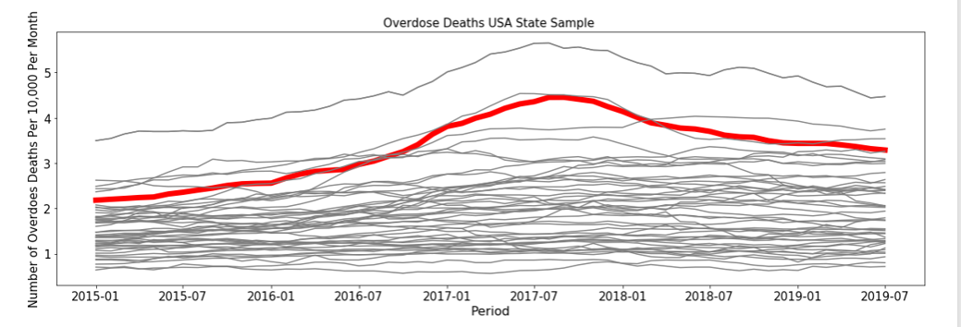
Overdose Fatalities 2015-2019 (Monthly Deaths per 10,000 Population)
Out of all 50 states, Pennsylvania had the 5th highest proportion of overdose deaths.
Notes:
Data source is Census Bureau and CDC (“2019 Annual Surveillance Report of Drug-Related Risks and Outcomes”) Not all 50 states drawn for clarity.
Data not sufficient to explain why spike in 2017 we can only speculate
Suggestions for revision: 49 thin gray lines and one thick red line, or top ten with 4 above PA and 5 below

Slide 5
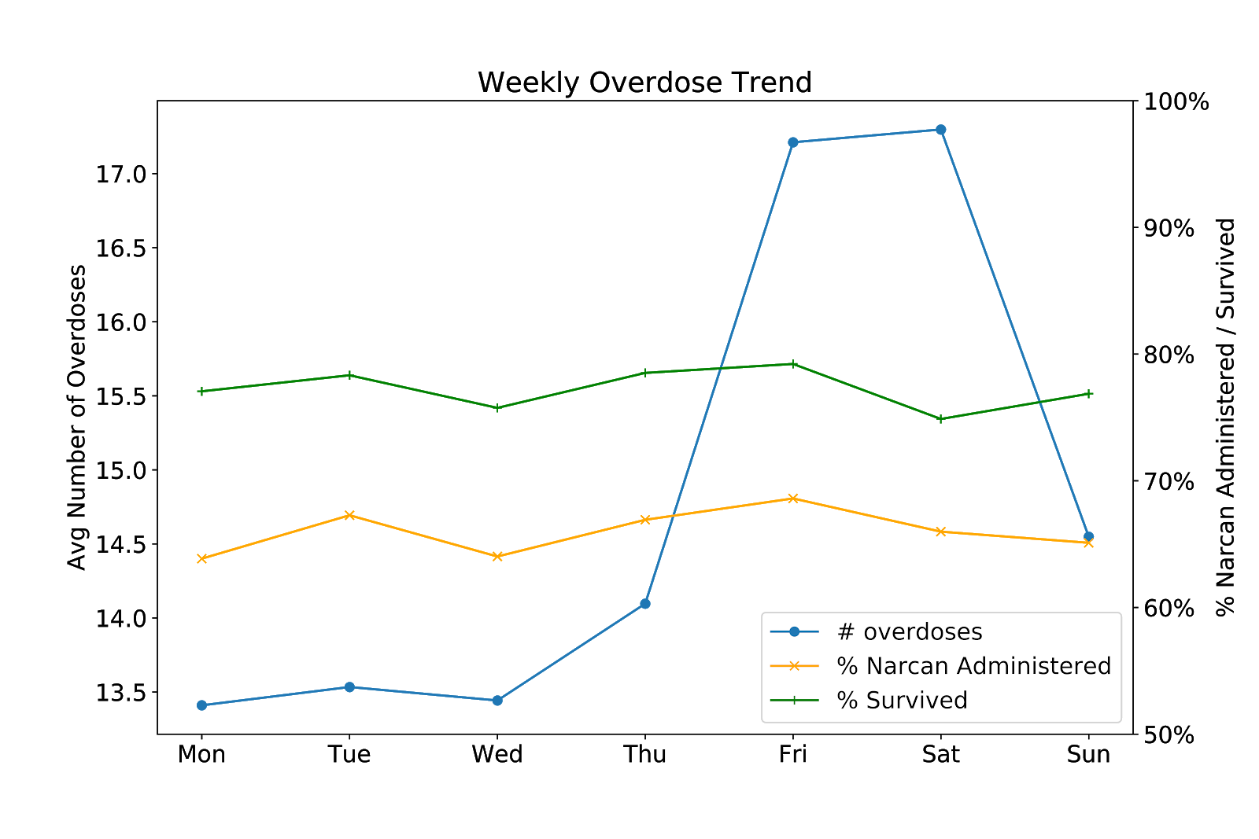
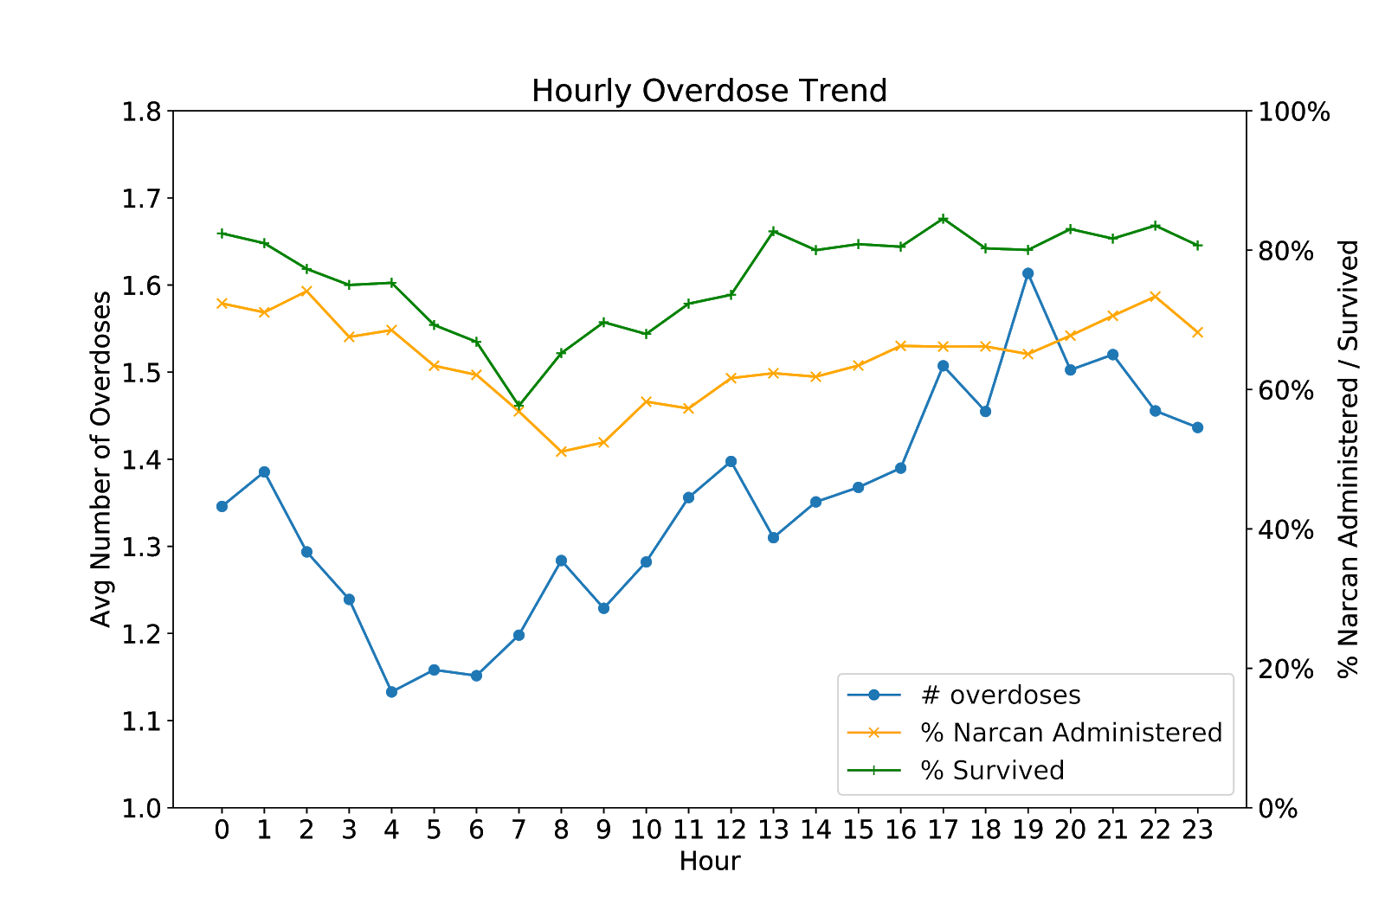
When do Pennsylvania overdoses peak?
Notes:
Stella: In the following figure, the average daily number of overdose ranges between 13.4 and 17.3 cases per day. Overdose cases start to rise on Thursdays and peak on Fridays and Saturdays. The % of cases administered with Narcan and the survival rate track each other consistently. Days that have higher rates of Narcan administered also see higher survival rates, except the slight discrepancy on Sundays. Narcan administration rate averages 66.0%, and survival rate averages to be 77.2%. The peak overdose on Saturdays also coincides with one of the lowest Narcan administration rates and survival rates, calling for greater availability of Narcan on Saturdays due to the case loads. Wednesdays, despite relatively lower overdose cases, see another low point in Narcan administration and survival rates, suggesting possibly fewer good samaritans in the middle of the week.
In the following figure, the average hourly number of overdoses ranges between 1.1 and 1.6 cases per hour. Overdose cases start at the lowest around 4am and gradually climb up to 7pm to reach the peak. Between 5pm and midnight see the most overdose cases. Consistent with the weekly trends, the narcan administration and survival rates track each other consistently. We do see greater variability in the Narcan administration rate as the day goes by. Every morning between 8am and 9am see the lowest percentage of cases administered with Narcan at about only 50%, compared to the hourly average 65%. The lowest survival rate happens in the 7th hour of the day.

Slide 6
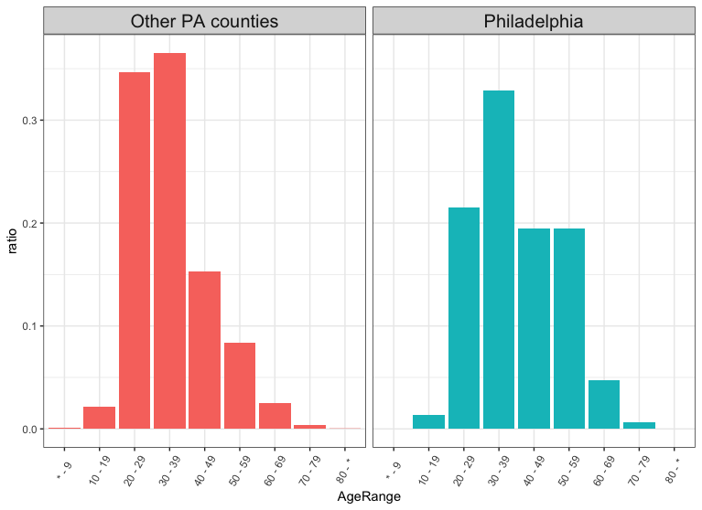
People aged 30-39 make up the highest percentage of overdose incidents in PA
Notes:
Other PA counties follow bell curve, Philadelphia skews older. 30-39 peak in both groups
Y axis is percentage within total OD group not total population.
For context, can we show distribution of ages in total PA population, inside and outside PA?
Possible merge two youngest and two oldest (note - also done for regression analysis)

Slide 7
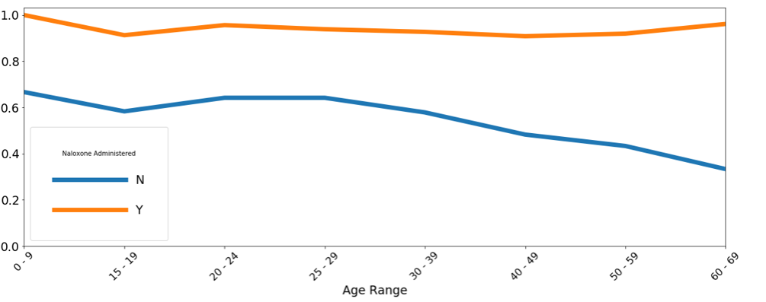
Survival rates by age range:
Notes:
Certain age groups 30+ are more vulnerable to death from overdose if Narcan is not administered. However, Naloxone greatly reduces that risk

Slide 8
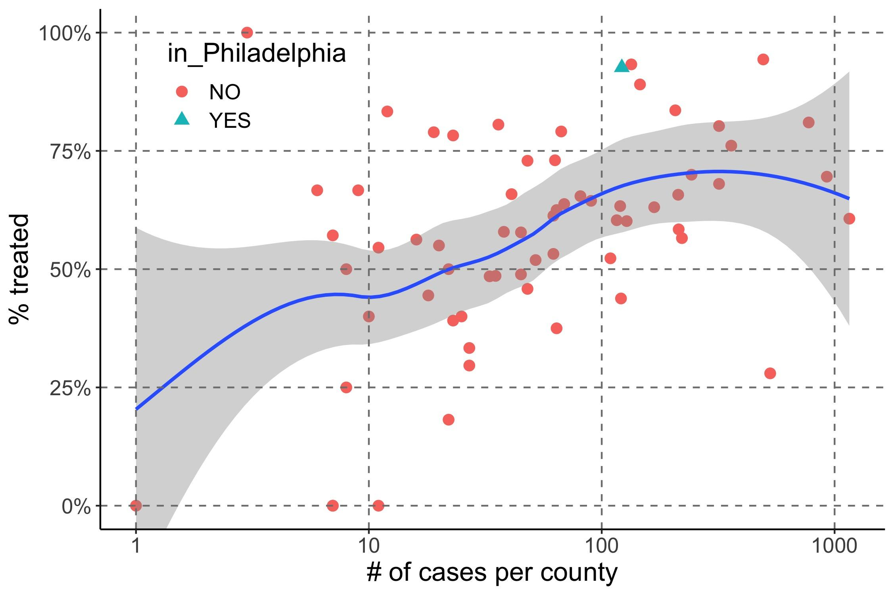
Narcan treatment rate increases with OD case load
Philly
Notes:
BACKGROUND INFO: Local polynomial regression used to smooth data. Shaded region is 95% confidence interval. Log 10 scaling of X axis for clarity.
This graph reflects the ADMINISTRATION rate of narcan relative to all overdose events per county (not survival)
Underlying data: PA.gov data (the big one)
Philadelphia has higher # of cases and use of Narcan but is not an outlier

Slide 9
Saving Lives: Naloxone administration

Slide 10
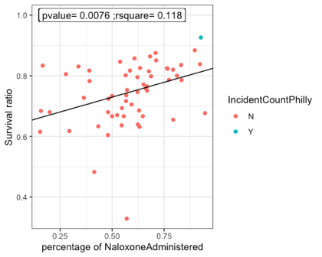
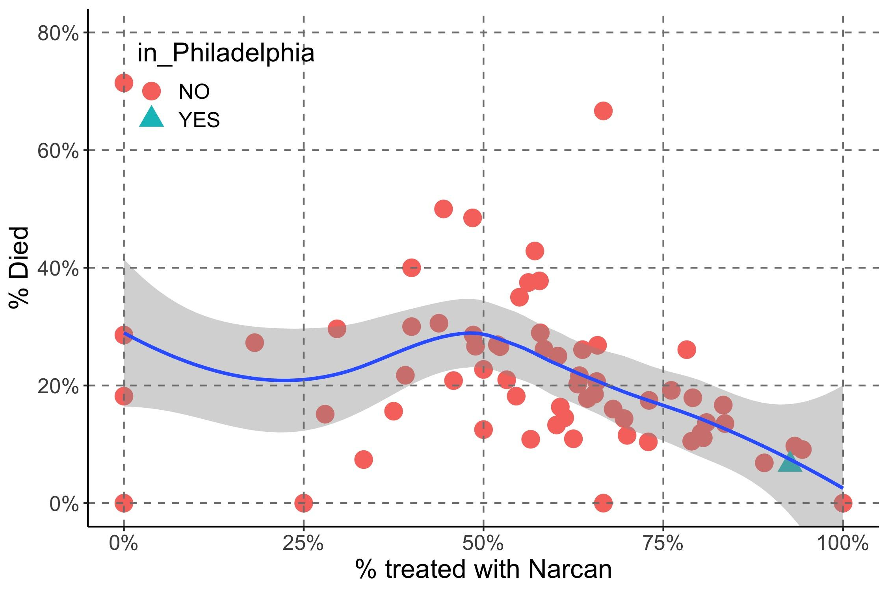
Higher rates of Narcan administration are associated with lower overdose death rates for PA counties
This association may reflect greater efficacy with more experience with Narcan and/or OD cases.
Philly
Notes:
BACKGROUND: Here, “death” refers to actual death events in data (not predicted feature like survival rate)
Underlying data: PA.gov

Slide 11
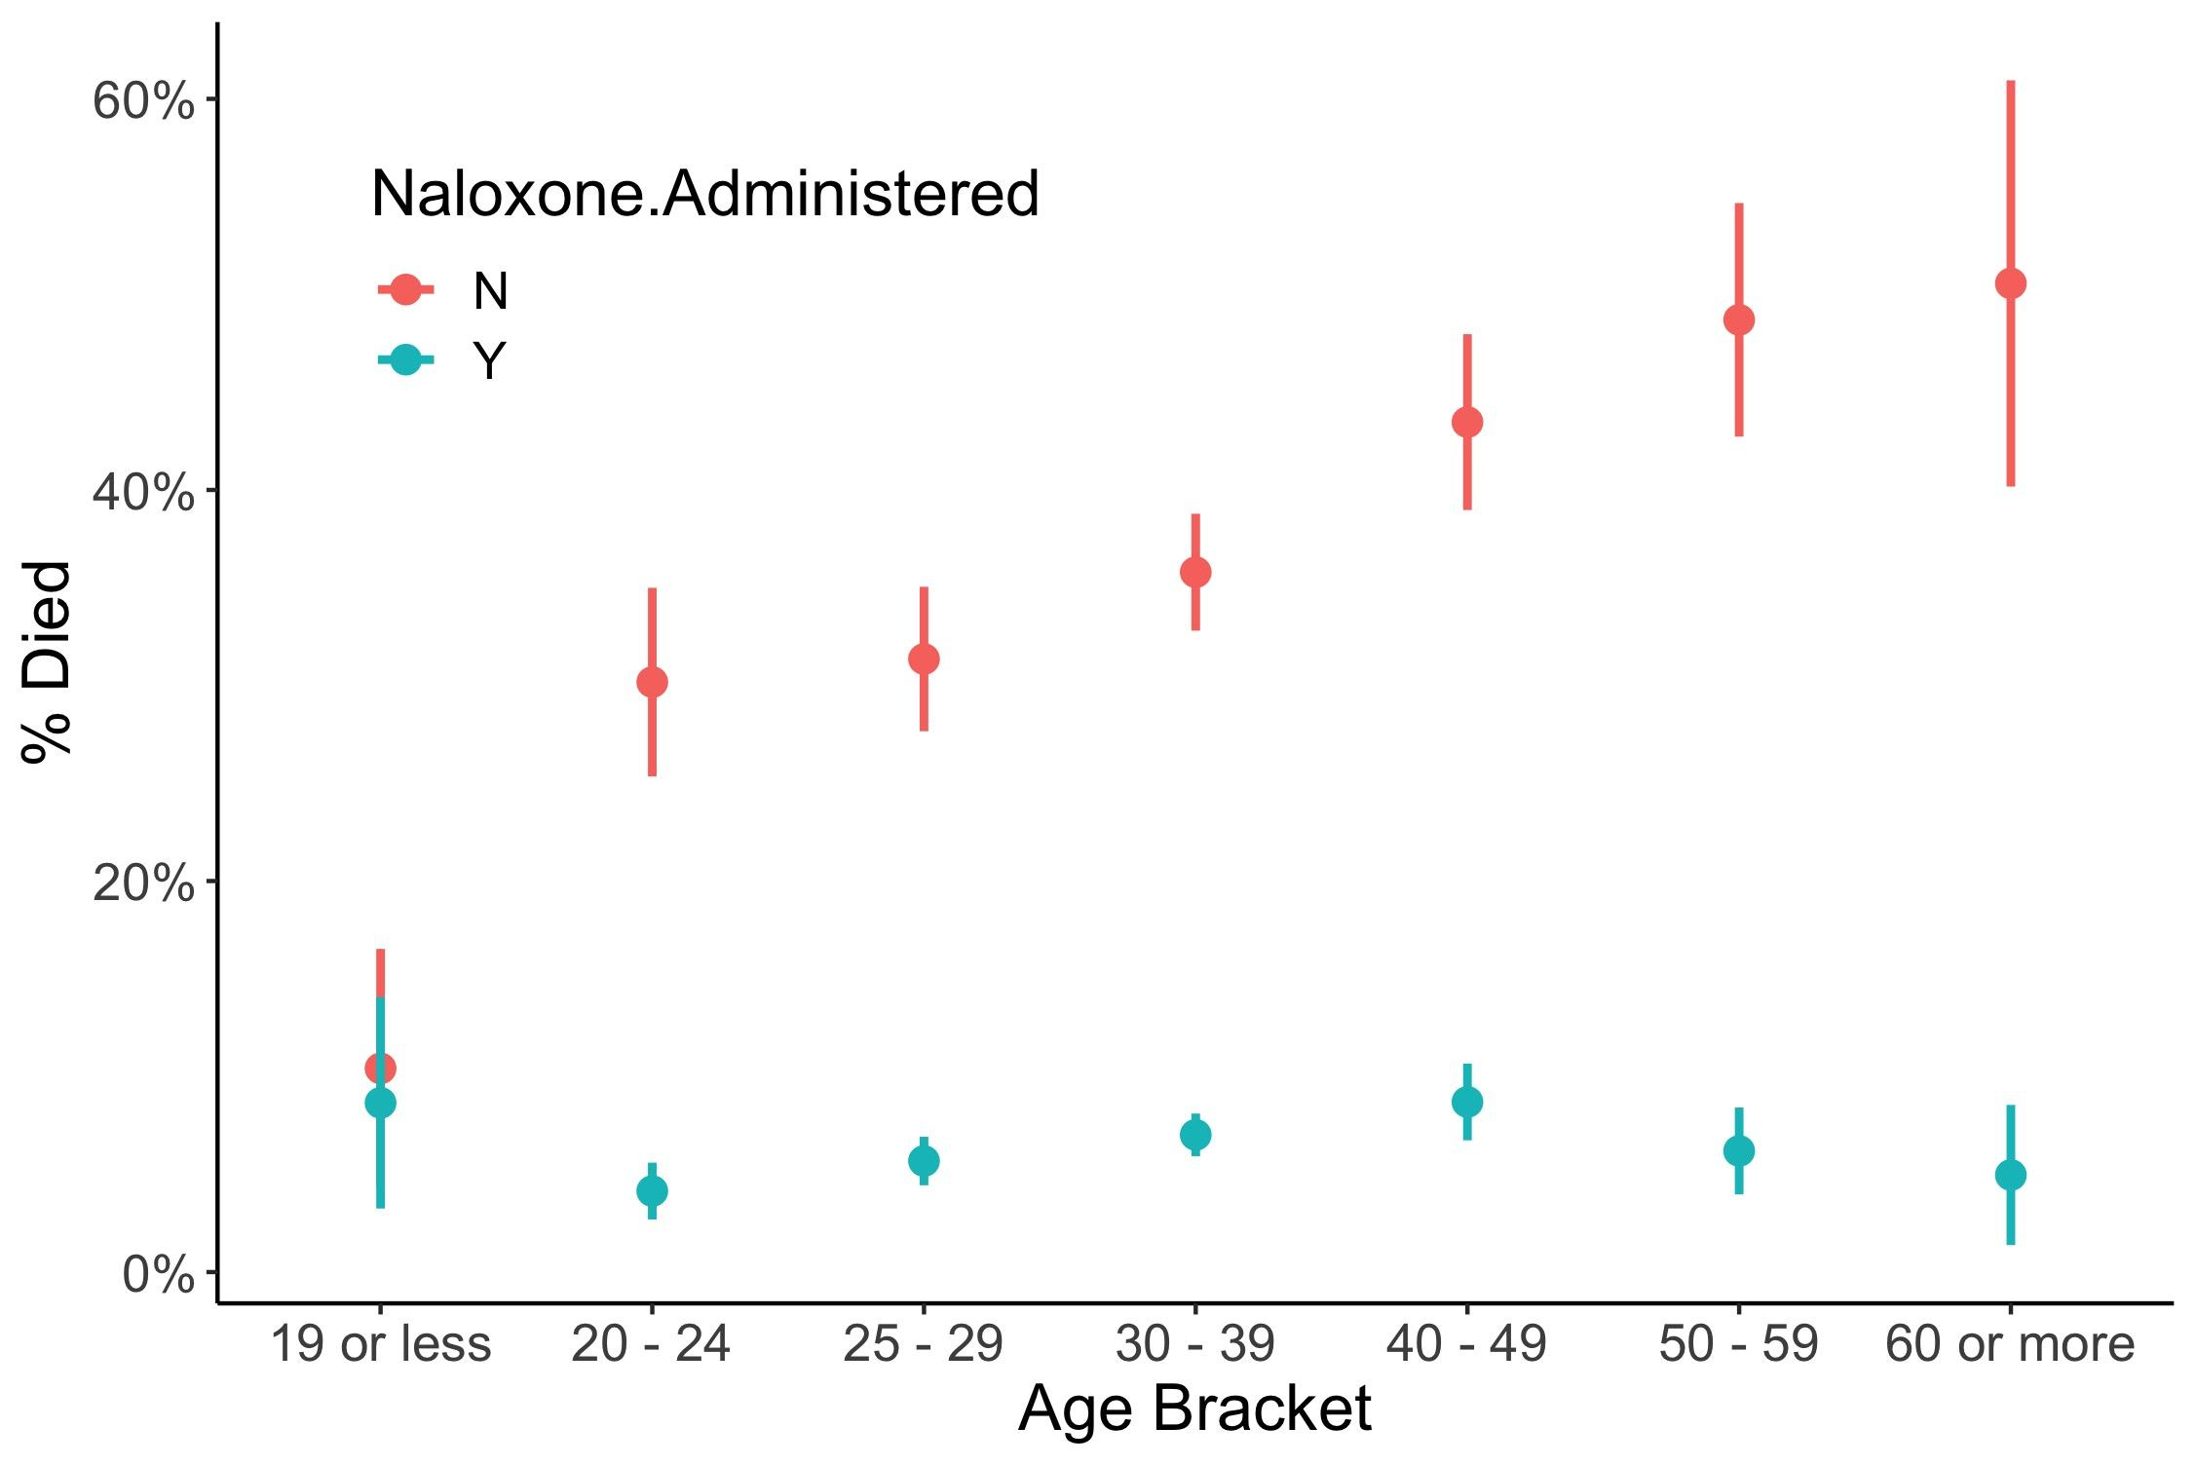
Naloxone administration in PA is associated with lower death rates across age brackets
Higher effect for older patients and lack of effect for youngest patients may reflect either pharmacology of Narcan or OD patterns
Notes:
BACKGROUND INFO Error bars are 95% confidence interval based on the Gaussian approximation for standard error of proportions

Slide 12
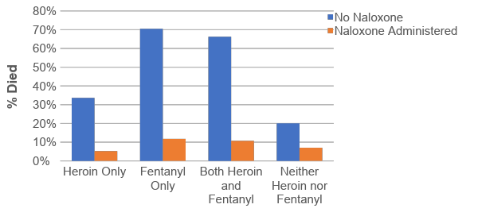
Naloxone administration in PA is associated with lower death rates for heroin and fentanyl
Notes:
Note: Next slide presents these same data in table form, with added details
For edit: Consider adding odds ratio immediately above bars per pair (and stars for significance)

Slide 13
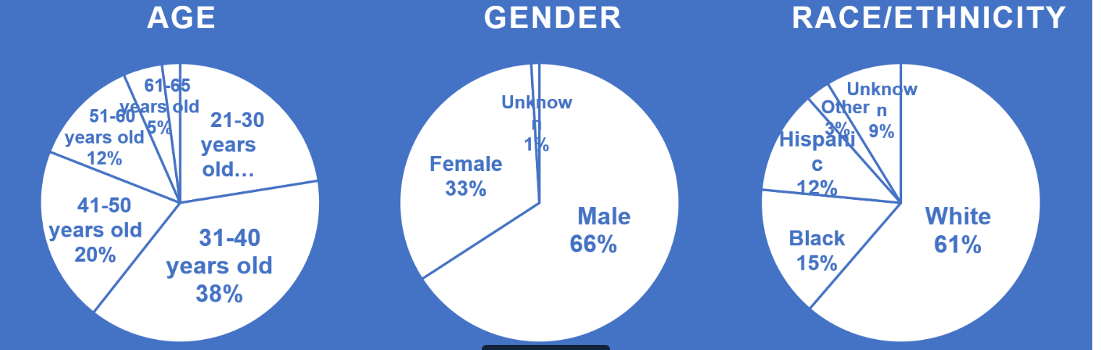
Prevention Point Naloxone Participants
Prevention Point served 2,359 participants in 2018

Slide 14
Prevention Point naloxone participants in 2018 reported
2,435 overdoses involving heroin
1,471 overdoses involving fentanyl
In 60% of overdoses, EMS were not called
In 62% of overdoses, the victim was not taken to the ED
A total of 3,767 naloxone refill events at Prevention Point
Notes:
Prevention Point data saying “who they are”, best they can do with survey-collection methods

Slide 15
Conclusions
Pennsylvania data show that naloxone administration is associated with lower probability of death from drug overdoses.
Prevention Point is an important source of naloxone for Philadelphia residents.
Certain age groups are more vulnerable to overdose. Naloxone is consistently protective across all age groups.
Critical saturation of use of Narcan matters. Counties with more overall use of Narcan have higher survivability. (From 50% towards 100% administration).
We have the most detailed data at county-level. Need to learn more about individuals and communities, need more federal/cooperative data sources.
Notes:
Takeaways:
PA.gov is the most “useful”/thorough data, relative to Prevention Point and CDC. (Evidence of the importance of well-funded data collection efforts). Commend reporting efforts for other organizations to follow (effort from police).
Importance of having someone dedicated to this data collection
Vulnerable age groups.
[Call for action - improve data gathering, reiterate saturation and age group difference]

